Slide 1
Team OBD
Michael Dykema, Emily Linderman,
Tom Lobbestael, Jacob Johnson

Slide 2
Project Summary
An AWS data pipeline that will provide users with suggested content based on previously viewed content on odb.org. This pipeline is made up of a data lake that receives incoming data, a recommendation engine that makes recommendations based on the data from the lake, and an api that will export recommendations to odb.

Slide 3
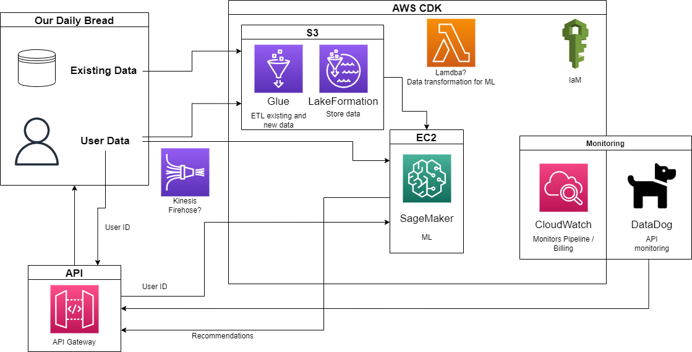
Architecture Overview

Slide 4
Issues
Delayed access to ODB’s AWS organization
Very limited access and red tape from ODB hierarchy
Pull Request review and publishing done by ODB
Different than initially expected and slows progress

Slide 5
Intended and Actual Progress - Michael
Complete
API Initialized
Setup with simple Lambda function for now
Helped with Cloud Watch infrastructure
Connected to API to monitor errors and cost
Helped with Lake Formation
Incomplete
Connecting API to SageMaker/Recommendation engine

Slide 6
Intended and Actual Progress - Emily
Complete
Get Access to AWS
Research - Cloudwatch
Metric Data
Alarm Creation
Log Groups
Implementation
Beginnings of Cloudwatch skeleton
Incomplete
Research
Cloudwatch Events
Cloudwatch Dashboards

Slide 7
Intended and Actual Progress - Tom
Complete
Get Access to AWS
Research - SageMaker
Bucketing
Tensorflow
Implementation
SageMaker Initial Implementation
Incomplete
Research
SageMaker Pipelining
Further Improvement of Algorithm

Slide 8
Intended and Actual Progress - Jacob
Complete
Get Access to AWS
Research - Lake Formation
Crawlers
Data ingestion
Log Groups
Implementation
Data lake skeleton
Incomplete
Data lake deployment
Existing data ingestion into data lake

Slide 9
Incomplete
Import existing data into Data Lake - Waiting on ODB
Stream Data into Data Lake - Waiting on ODB
Connect API to recommendation engine

Slide 10
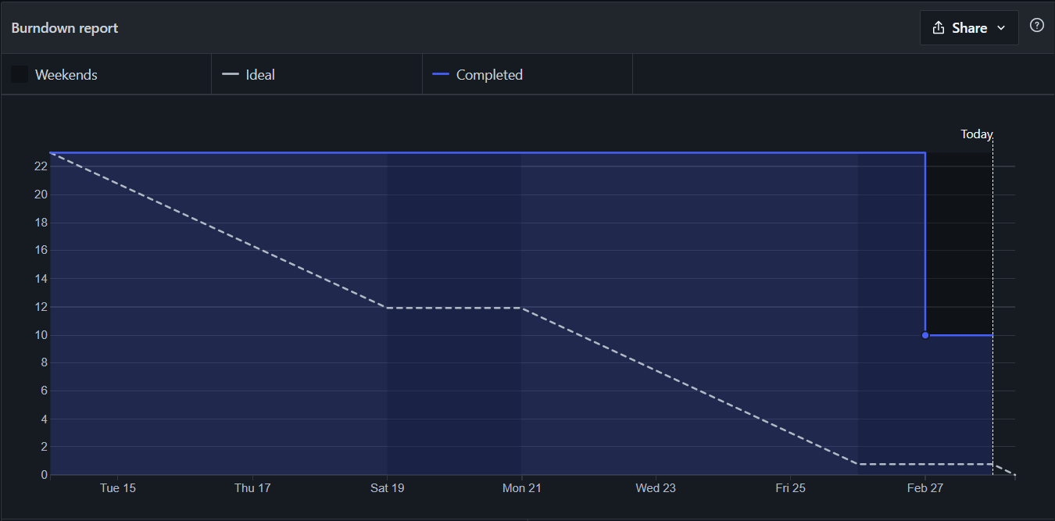
Burndown

Slide 11
Sprint #3 Project Progress
Overall Goals:
Data
Import data
ODB responsibility
Stream new data in
Recommendation
Initialize SageMaker
Train model
API
Connect to recommendation engine
Monitoring
Connect to other service besides API
Individual Goals:
Jacob
Configure Glue for streaming data
Tom
Initialize SageMaker
Michael
Finish API
Emily
Initialize Cloud Watch dashboard

Slide 12
Demo coming next presentation

Slide 13
Questions?

